Slide 1
Advanced Object–Oriented Design &Programming (AOODP) Seminar – 3: Unit 4 Design Patterns II – Structural Patterns
Dr. Anupam Mazumdar
Email: anupam.mazumdar@kaplan.com
anupam.mazumdar@aspectworld.com
14/11/2025

Slide 2
Outlines of the Seminar -3
Introduction to Structural Design Patterns
Purpose and Use Cases of Structural Design Patterns
Types of Structural Design Patterns:
- Adapter
- Bridge
- Composite
- Decorator
- Façade
- Proxy
- Flyweight
Explain how Structural Design Patterns Enable Modular and Flexible Code
Practical Exercises & Answers
- Implement the Decorator Pattern in Python to enhance the functionality of an existing class
- Create a coffee shop application where you can dynamically add toppings (e.g., milk, sugar) to a base coffee object.
References

Slide 3
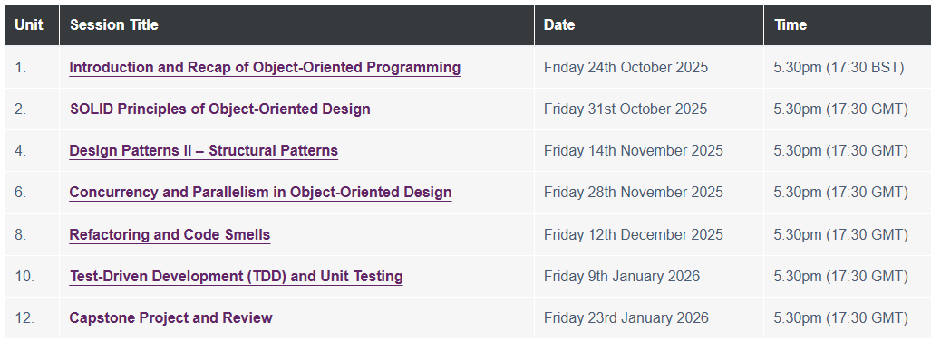
The organisation of the Seminars!

Slide 4
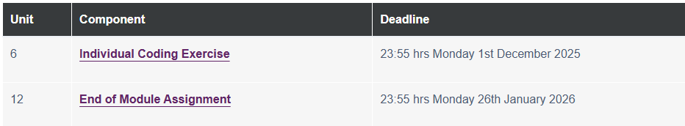
Deadlines of Assignment Submission

Slide 5
Introduction to Structural Design Patterns
Structural Design Patterns are a category of design patterns that deal with object composition, or the way entities are assembled to form larger, more complex structures.
The primary concern is not the creation of objects or the communication between them, but rather the architecture of relationships between objects.

Slide 6
Core Concept and Purpose
Simplifying Relationships
Decoupling Interfaces from Implementation
Managing Complexity

Slide 7
When are Structural Design Patterns Used?
Interface Incompatibility
Adding Responsibilities Dynamically
Complex Subsystem Access
Controlled Access
Representing Hierarchies

Slide 8
Types of Structural Design Pattern - 1
Adapter Design Pattern: Allows incompatible interfaces to work together by converting the interface of one class into another that clients expect.
Decorator Pattern: Adds new functionality to an object dynamically without altering its structure.
Façade Pattern: Provides a simplified interface to a complex subsystem.
Proxy Pattern: Provides a surrogate or placeholder for another object to control access to it.
Composite Pattern: Allows you to compose objects into tree structures to represent part-whole hierarchies.
Bridge Design Pattern: The Bridge pattern decouples an abstraction from its implementation so that the two can vary independently. It uses composition rather than inheritance to separate the interface from the implementation details.

Slide 9
How Structural Design Patterns Enable Modular and Flexible Code
Decoupling Components
- Separation of Concerns
- Loose Coupling
Interface Standardization
- Uniform Interfaces
- Interchangeability
Composition over Inheritance
- Runtime Flexibility
- Avoids Class Explosion
Abstraction Layers
- Complexity Hiding
- Client Simplicity

Slide 10
Seminar Task
Implement the Decorator Pattern in Python to enhance the functionality of an existing class.
Create a coffee shop application where you can dynamically add toppings (e.g., milk, sugar) to a base coffee object.

Slide 11
References!
Francesco, H. D. (2024) JavaScript Design Patterns: Deliver fast and efficient production-grade JavaScript applications at scale. 1st edition. Birmingham: Packt Publishing. https://essex.primo.exlibrisgroup.com/permalink/44UOES_INST/1h1udbn/cdi_askewsholts_vlebooks_9781804614020
Nesteruk, D. (2022) Design patterns in modern C++20 : reusable approaches for object-oriented software design. Second edition. [Online]. California: Apress. https://essex.primo.exlibrisgroup.com/permalink/44UOES_INST/ngp9lg/alma991008468503607346
Ayeva, K. & Kasampalis, S. (2024) Mastering Python design patterns : a craft essential Python patterns by following core design principles. Third edition. Birmingham, UK: Packt Publishing Ltd. https://essex.primo.exlibrisgroup.com/permalink/44UOES_INST/ngp9lg/alma991008701020807346
Nguyen Quan (2022) Advanced Python Programming (2nd Edition). Packt Publishing. https://essex.primo.exlibrisgroup.com/permalink/44UOES_INST/1h1udbn/cdi_knovel_primary_book_kpAPPE000C
Soshin, A. (2024) Kotlin Design Patterns and Best Practices : Elevate Your Kotlin Skills with Classical and Modern Design Patterns, Coroutines, and Microservices. Third edition. Birmingham, England: Packt Publishing. https://essex.primo.exlibrisgroup.com/permalink/44UOES_INST/ngp9lg/alma991008691705107346

